Slide 1
היסודות התיאורטיים של פדגוגיה של חוסן
פרופ' חיים שקד, נשיא המכללה
כנס אקדמי מקוון "חוסן וחינוך", כ"ד בתשרי תשפ"א – 12 באוקטובר 2020

Slide 2
פדגוגיה של חוסן: גישה הרואה את הגברת החוסן של התלמיד/ה כתפקיד מרכזי של הגננת/המורה בתוך תהליכי הוראה ולמידה.

Slide 3
מה?

Slide 4
Resilience: A Process Rather Than a Trait
The question of whether we believe an individual possesses the capacity for resilience is no longer appropriate. Everyone has the capacity for resilience. The question is whether it was tapped - and if not, what can we do to tap it?
(Truebridge, 2013, pp. xix)

Slide 5
Resilience: A Process Rather Than a Trait
Resilience… is the dynamic and negotiated process within individuals (internal) and between individuals and their environments (external) for the resources and support to adapt and define themselves as healthy amid adversity, threat, trauma, and/or everyday stress.
(Truebridge, 2013, pp. xx)

Slide 6
Resilience: Bounce Back or Resourcefulness
Resilient individuals use positive emotions to bounce back from negative emotional experiences.
(Tugade & Fredrickson, 2004)
The potential to exhibit resourcefulness by using available internal and external recources in response to different contextual and developmental challenges.
(Pooley & Cohen, 2010, p. 34)

Slide 7
למה?

Slide 8
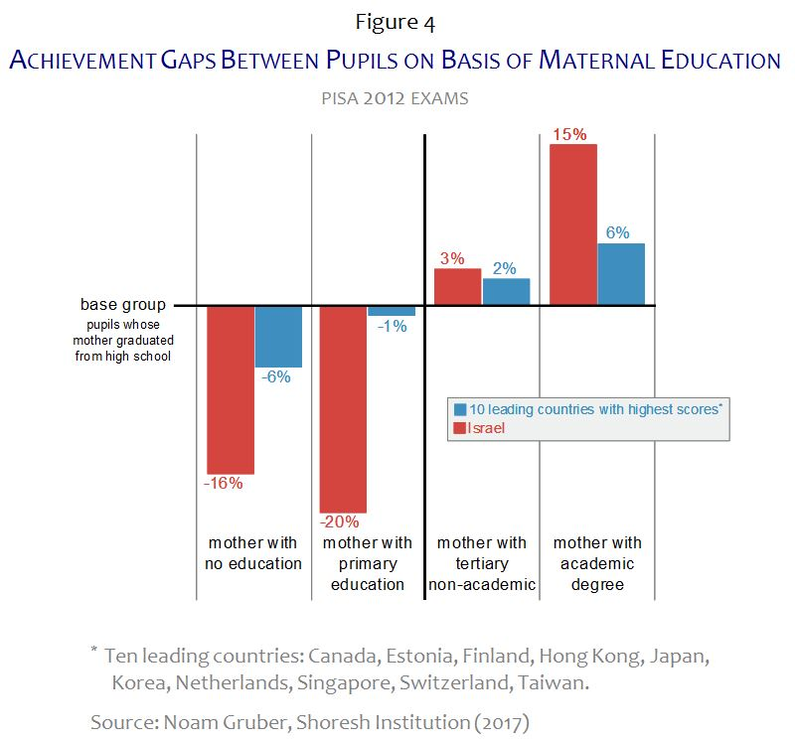

Slide 9
איך?

Slide 10
The Ordinariness of Resilience
What began as a quest to understand the extraordinary has revealed the power of the ordinary. Resilience does not come from rare special qualities, but from the everyday magic of ordinary, normative human resources in the minds, brains, and bodies of children, in their families and relationships, and in their communities.
(Masten, 2001, p. 235)

Slide 11
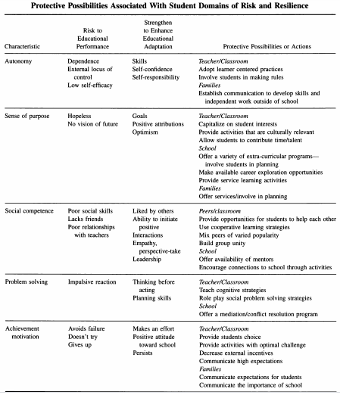
Protective Possibilities Associated With Student Domains of Risk and Resilience
(Morrison & Allen, 2007)

Slide 12
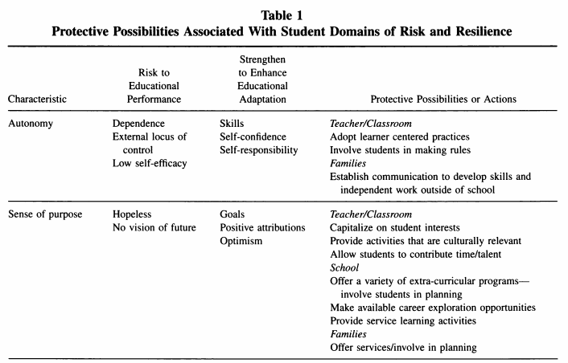

Slide 13
